Slide 1
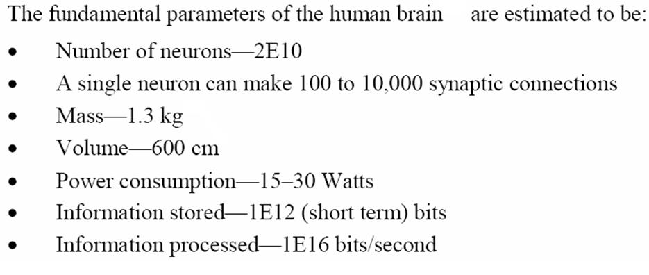
Will these devices make it? The answer is a very definite…..
Maybe!!

Slide 2
Why can’t your pc simply turn on like your television?
MRAM uses magnetism rather than electrical power to store bits of data.

Slide 3
CATEGORIZING STORAGE DEVICES
Storage devices hold data, even when the computer is turned off.
The physical material that actually holds data is called a storage medium. The surface of a floppy disk is a storage medium.
The hardware that writes data to or reads data from a storage medium is called a storage device. A floppy disk drive is a storage device.
The two primary storage technologies are magnetic and optical.

Slide 4
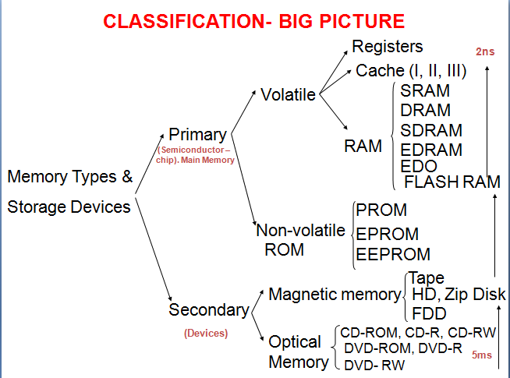

Slide 5
THE PRIMARY TYPES OF MAGNETIC STORAGE ARE:
Diskettes (floppy disks)
Hard disks
High-capacity floppy disks
Disk cartridges
Magnetic tape

Slide 6
THE PRIMARY TYPES OF OPTICAL STORAGE ARE:
Compact Disk Read-Only Memory (CD-ROM)
Digital Video Disk Read-Only Memory
(DVD-ROM)
CD-Recordable (CD-R)
CD-Rewritable (CD-RW)
PhotoCD

Slide 7
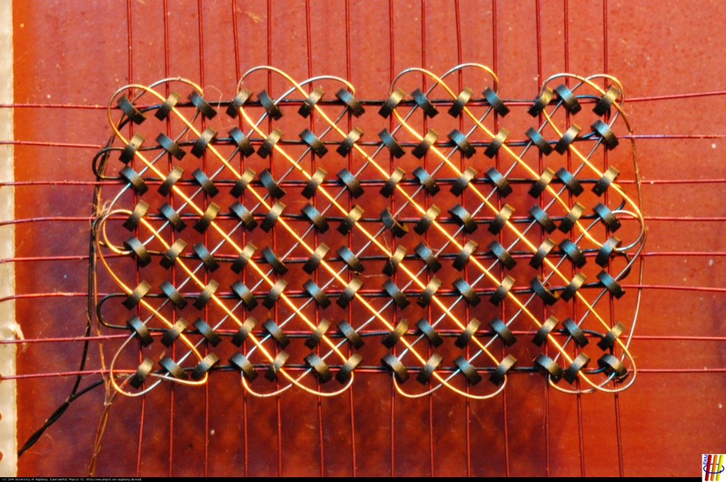
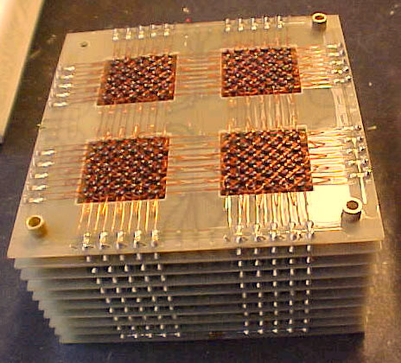
Magnetic Core RAM
By the early 1960’s, Magnetic Core RAM became largely universal as main memory, replacing drum memory

Slide 8
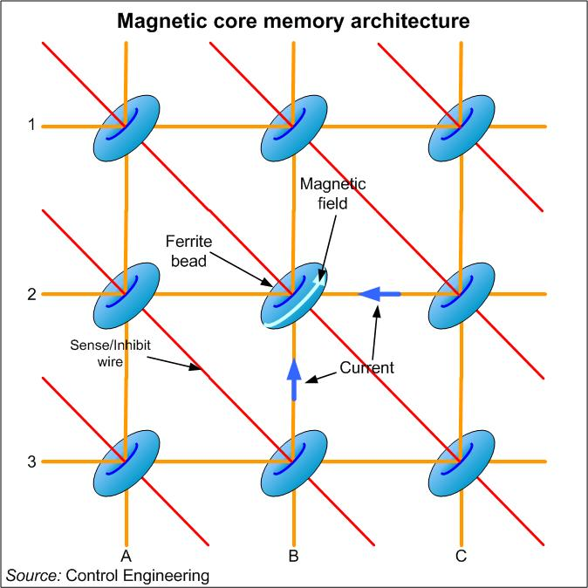
Magnetic Core RAM
The memory cells consist of wired threaded tiny ferrite rings (cores).
X and Y lines to apply the magnetic filed.
Sense/Inhibit line to ‘read’ the current pulse when the polarization of the magnetic field changes.

Slide 9
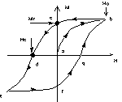
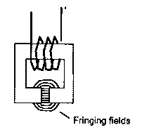
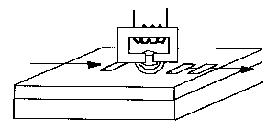
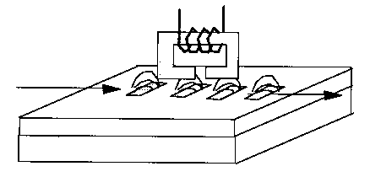
MAGNETIC RECORDING

Slide 10
HOW MAGNETIC STORAGE WORKS
A magnetic disk's medium contains iron particles, which can be polarized—given a magnetic charge—in one of two directions.
Each particle's direction represents a 1 (on) or 0 (off), representing each bit of data that the CPU can recognize.
A disk drive uses read/write heads containing electromagnets to create magnetic charges on the medium.

Slide 11
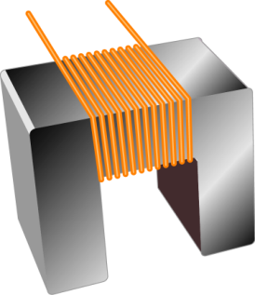
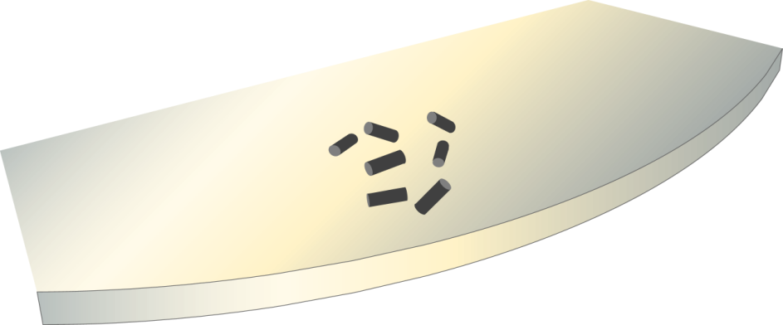
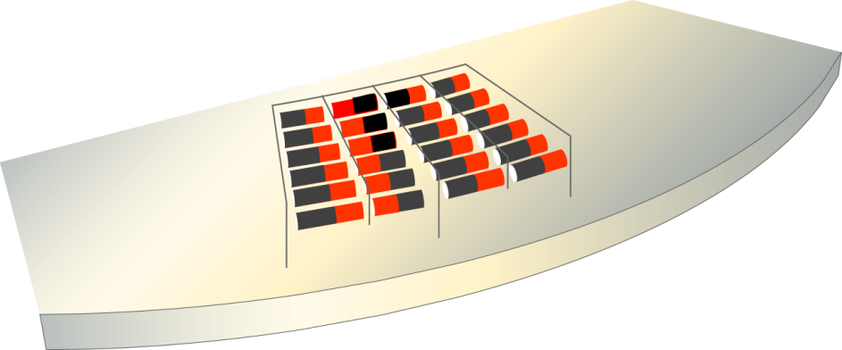
Write head
Medium
Random particles
(no data stored)
Current flow
(write operation)
Organized particles
(represent data)

Slide 12
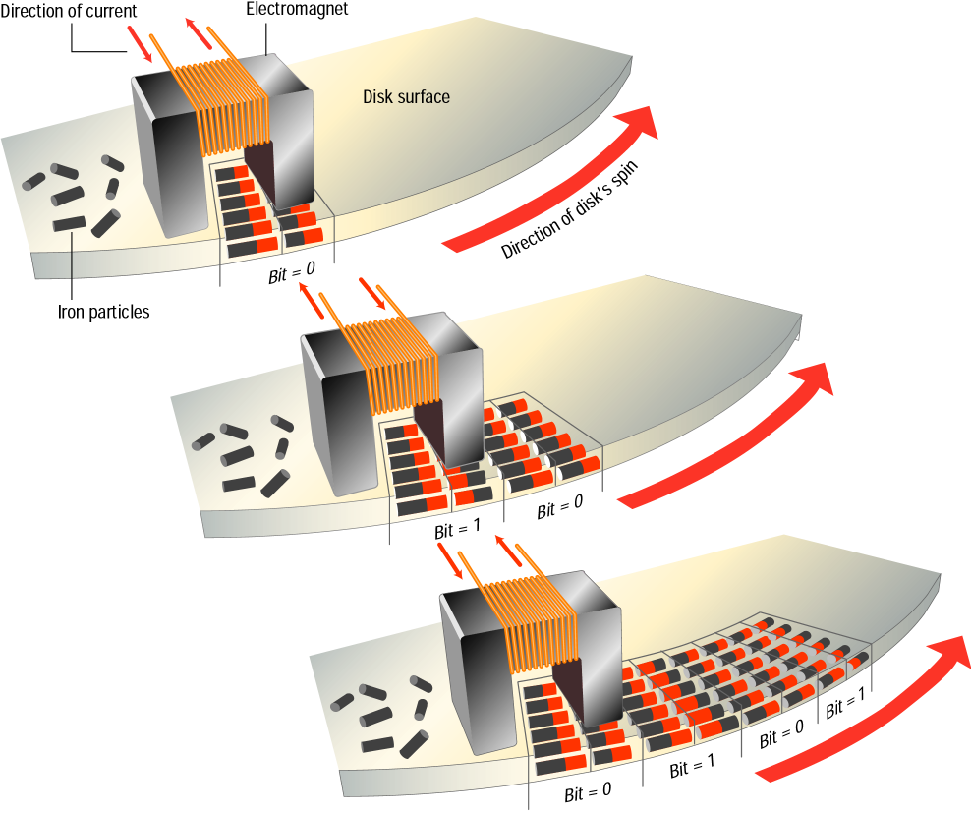
As the medium
rotates, the head
writes the data.

Slide 13
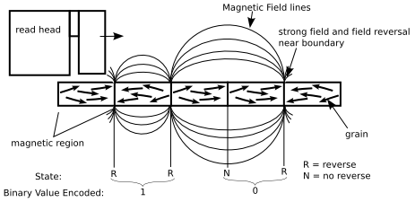
non-volatile memory devices
“Permanent” memory state
Large writing currents required
Density of “grains”, read/write limiting factor

Slide 14
FORMATTING
Before a magnetic disk can be used, it must be formatted—a process that maps the disk's surface and determines how data will be stored.
During formatting, the drive creates circular tracks around the disk's surface, then divides each track into sectors.
The OS organizes sectors into groups, called clusters, then tracks each file's location according to the clusters it occupies.

Slide 15
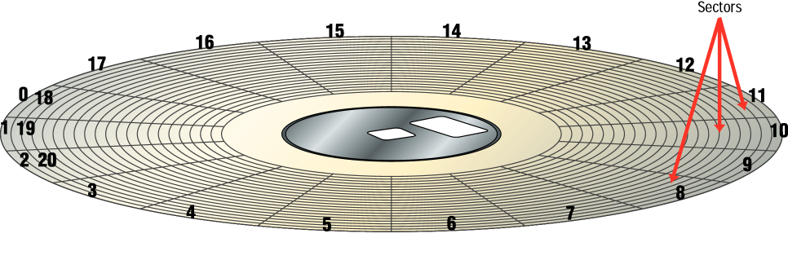
Formatted Disk

Slide 16
DISK AREAS
When a disk is formatted, the OS creates four
areas on its surface:
Boot sector – stores the master boot record, a small program that runs when you first start (boot) the computer
File allocation table (FAT) – a log that records each file's location and each sector's status
Root folder – enables the user to store data on the disk in a logical way
Data area – the portion of the disk that actually holds data

Slide 17
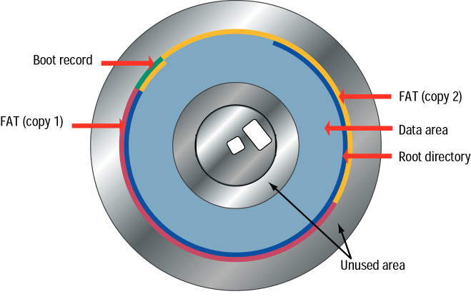

Slide 18
MAGNETIC STORAGE DEVICES - DISKETTES
Diskette drives, known as floppy disk drives, read and write to diskettes (called floppy disks or floppies).
Diskettes are used to transfer files between computers, as a means for distributing software, and as a backup medium.
Diskettes come in two sizes: 5.25-inch and 3.5-inch.

Slide 19
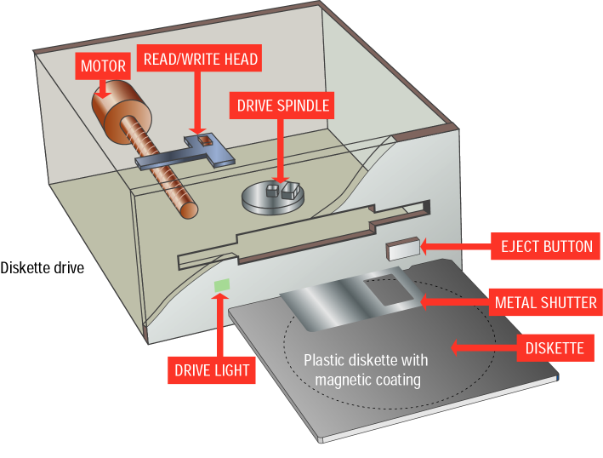
3.5 inch
floppy
and drive

Slide 20
Hard Disk Drive
Purpose:
Long-term, nonvolatile storage
Large, inexpensive, slow level in the storage hierarchy
Disk composition
A magnetic disk consist of a collection of platters (1to 20 per disk) that rotate on a spindle.
Disk surface divided into tracks (1000 to 4800 per platter).
Tracks are divided into sectors (64 per track), which are the smallest unit that can be read or written.
Up to 10,000 rpm

Slide 21
HARD DISKS
Hard disks use multiple platters, stacked on a spindle. Each platter has two read/write heads, one for each side.
Hard disks use higher-quality media and a faster rotational speed than diskettes.
Removable hard disks combine high capacity with the convenience of diskettes.

Slide 22
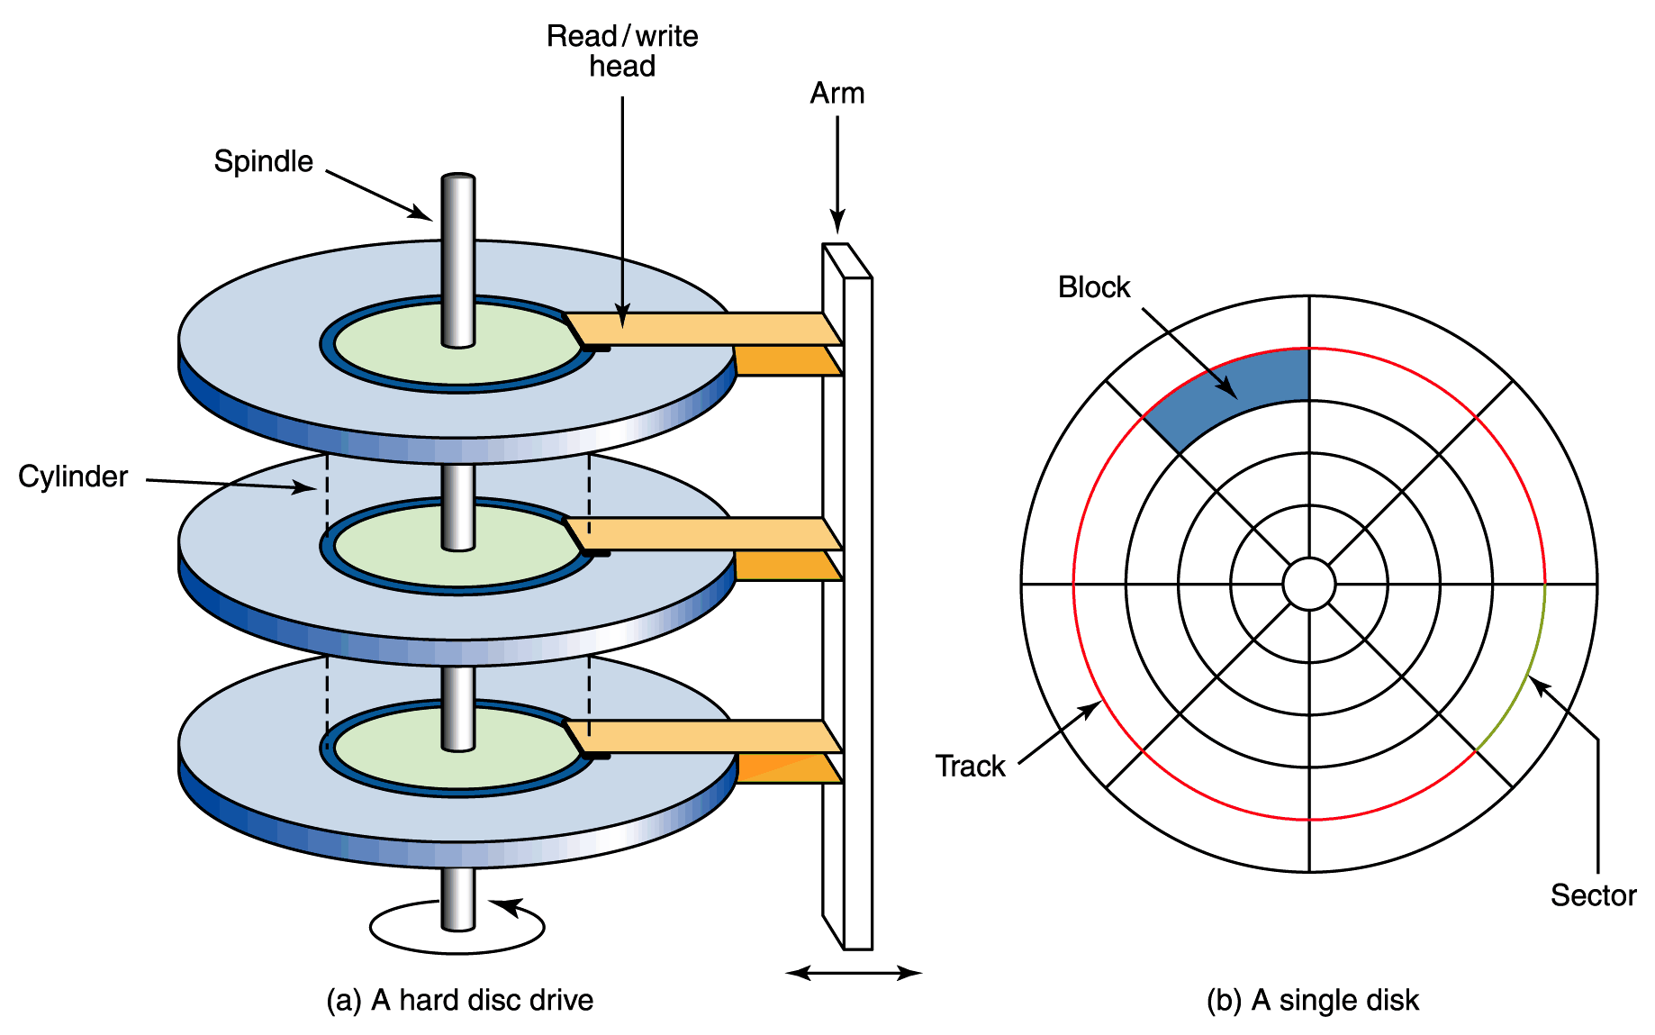
Magnetic Disks
A read/write head travels across a spinning magnetic disk, retrieving or recording data
The organization of a magnetic disk

Slide 23
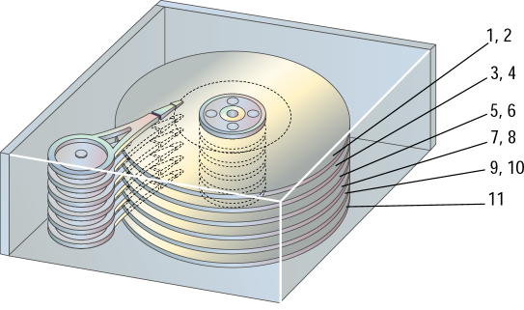
Read/write heads

Slide 24
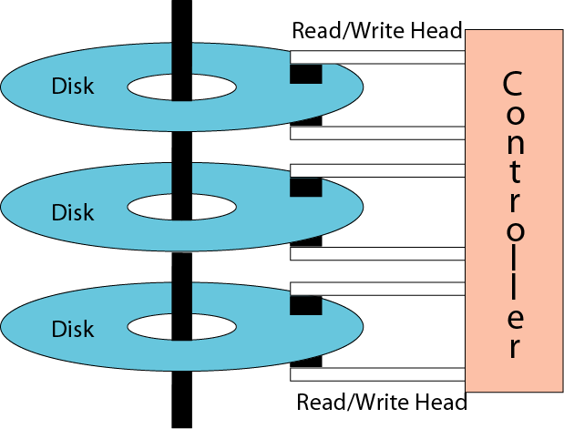
Physical layout of a magnetic disk

Slide 25
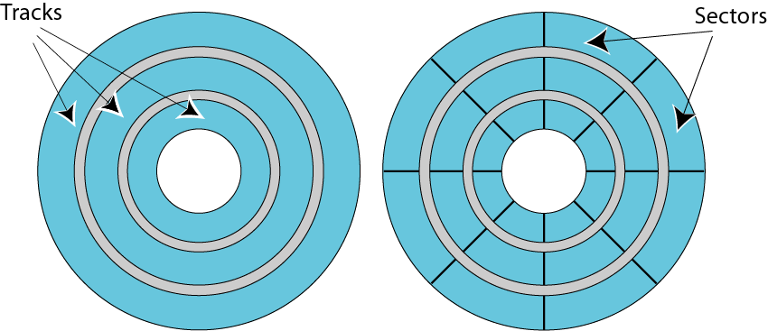
Surface organization of a disk

Slide 26
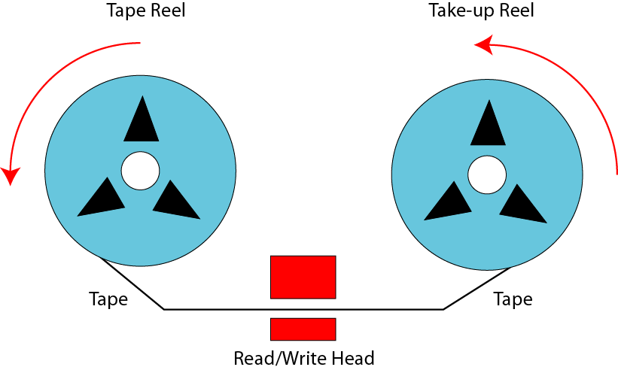
Mechanical configuration of a tape

Slide 27
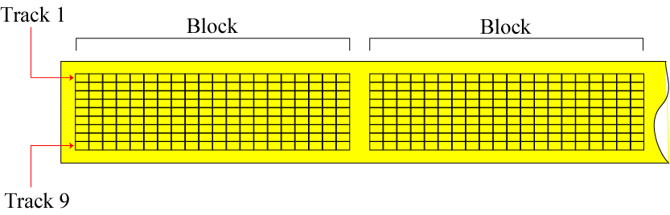
Surface organization of a tape

Slide 28
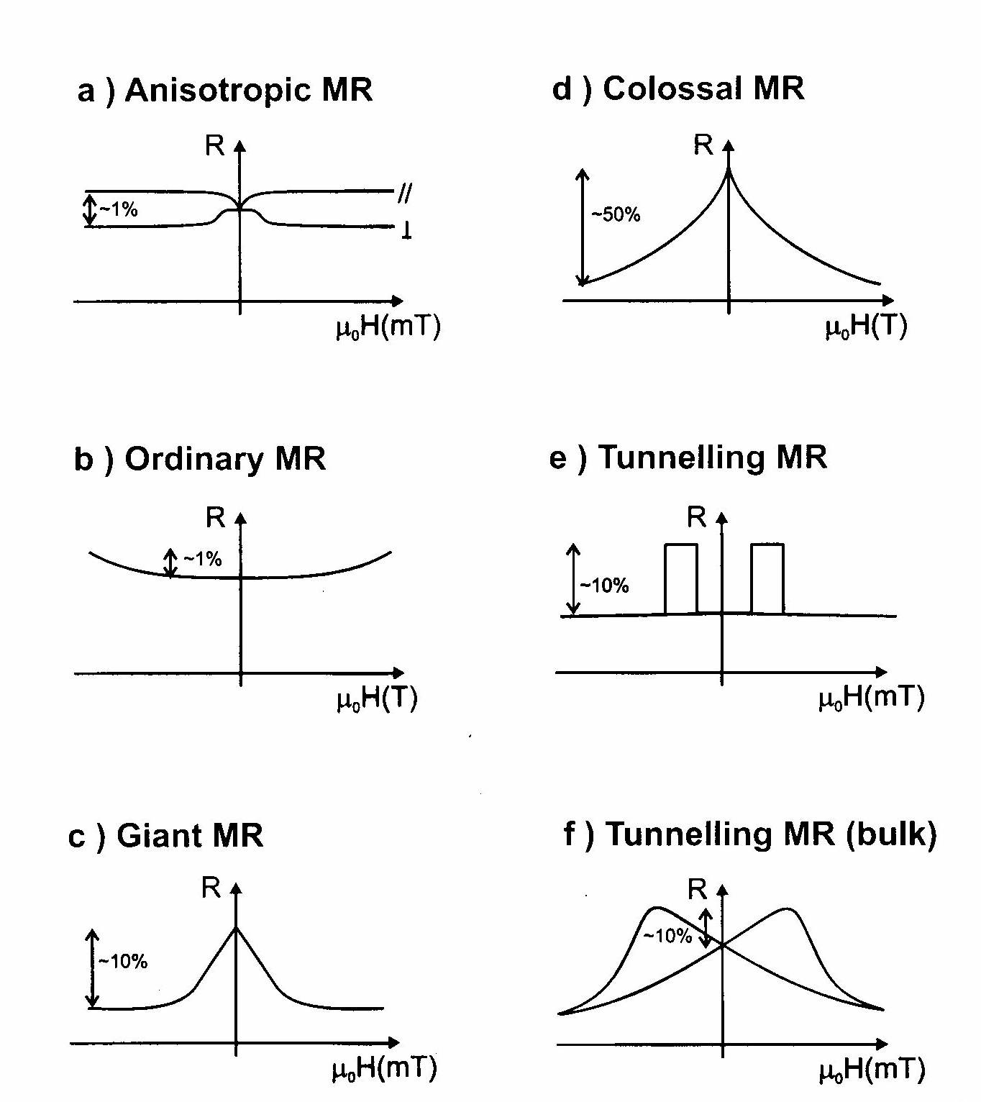

Slide 29
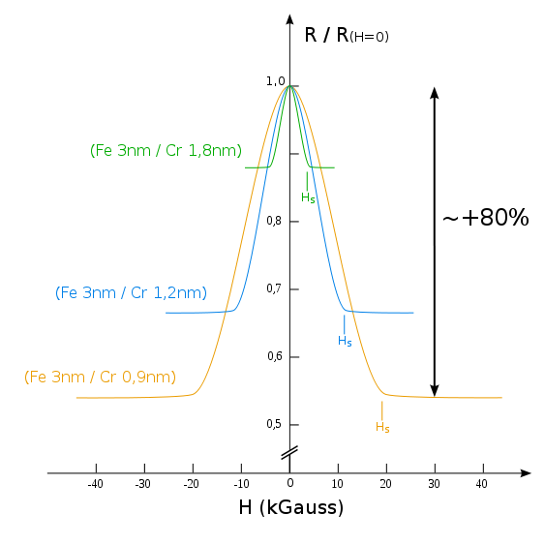
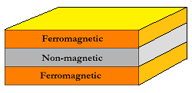
Giant Magnetoresistance (GMR)
Two thin films of altering ferromagnetic materials and a non-magnetic layer-spacer.
10-80% decrease in electrical resistance

Slide 30
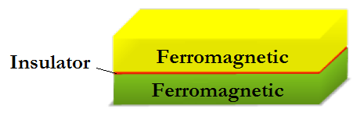
Tunnel Magnetoresistance (TMR)
Two thin films of altering ferromagnetic materials and an insulating spacer.
Fe/MgO/Fe junctions reach over 200% decrease in electrical resistance at room temperature
600 (room temperature)-1100 (4.2 K) % TMR at junctions of CoFeB/MgO/CoFeB

Slide 31
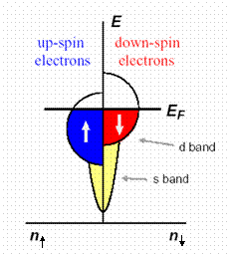
Tunnel Magnetoresistance (TMR)
In ferromagnetic metals electronic bands are exchange split which implies different densities of states at the Fermi energy for the up- and down-spin electrons.

Slide 32
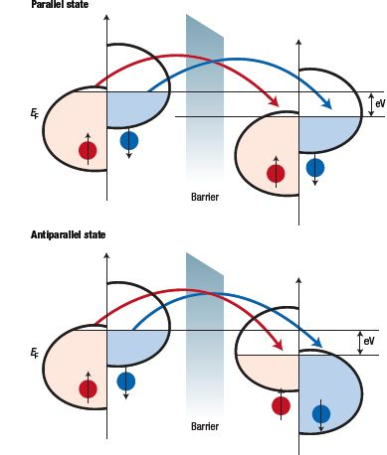
Tunnel Magnetoresistance (TMR)
Spin of electrons is conserved in the tunneling process.
Tunneling of up- and down-spin electrons are two independent processes → conductance occurs in the two independent spin channels.
Electrons originating from one spin state of the first ferromagnetic film are accepted by unfilled states of the same spin of the second film.

Slide 33
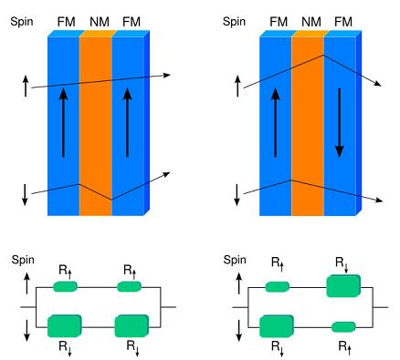
Spin Valve GMR
Hard layer: magnetization is fixed.
Soft layer: magnetization is free to rotate.
Thin non-ferromagnetic spacer ~3 nm.
Spacer material Cu (copper) and ferromagnetic layers NiFe (permalloy).
This configuration used in hard drives.

Slide 34
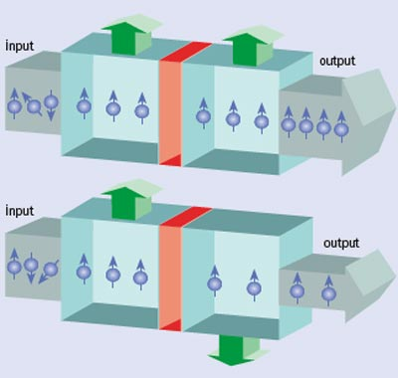
Magnetic Tunnel Junction (MTJ)
Commonly used insulating materials are Aluminum oxide (Al₂O₃) and crystalline Magnesium oxide (MgO)

Slide 35
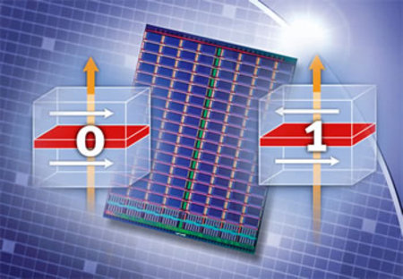
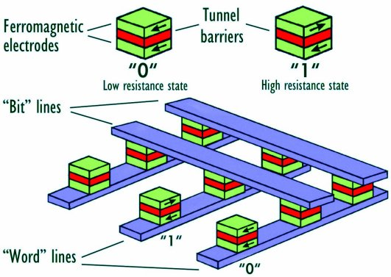
MRAM
One of the two plates is a permanent magnet set to a particular polarity, the other's field will change to match that of an external field.

Slide 36
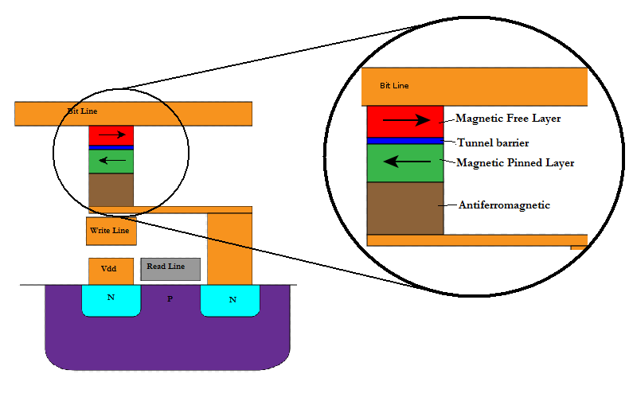
MRAM: Fixed layer
The bottom layers give an effect of fixed (pinned) layer due to interlayer exchange coupling between ferromagnetic and spacer layer of synthetic antiferromagnetic.

Slide 37
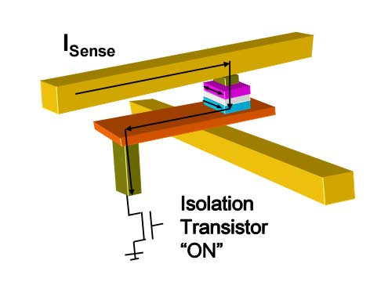
MRAM: Reading process
Transistor is “ON”
Measuring of electrical resistance of a small sense current from a supply line through the cell to the ground.

Slide 38
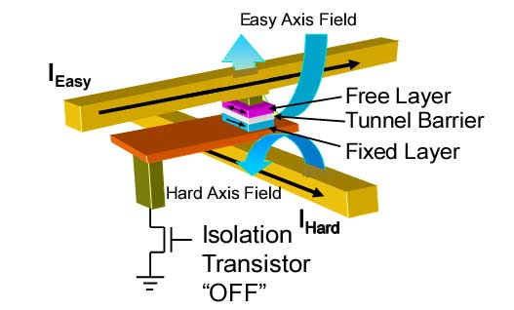
MRAM: Writing process
Transistor is “OFF”
When current is passed through the write lines, an induced magnetic field is created at the junction, which alters the polarity of the free layer.

Slide 39
MRAM: Writing process
In order to change the polarity of the free layer, both fields are necessary.
Only the bit in which current is applied in both hard and easy axis will be written. The other bits will remain half-select.

Slide 40
MRAM: Characteristics
Non-volatility
Infinite endurance
High speed performance
Low cost

Slide 41
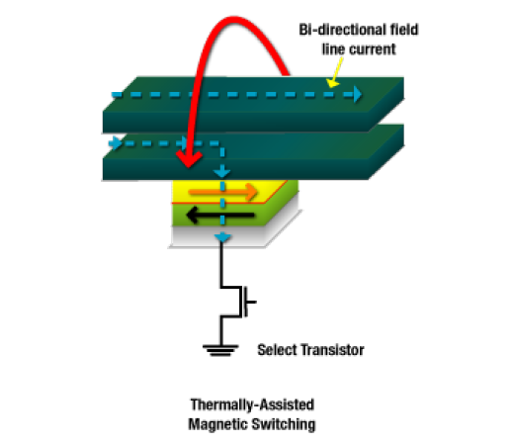
Future MRAM Improvements
Thermal Assisted Switching
Solves the first-generation selectivity and stability problems
Cost-effective and scalable memory technology to at least the 32nm node

Slide 42
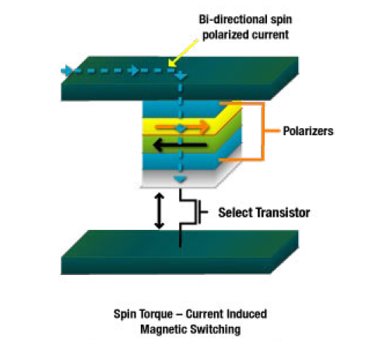
Future MRAM Improvements
Spin Torque Transfer
No applied magnetic field
Utilizes heavily spin polarized current
The magnetization of nano-elements is flipped back and forth
Still has challenges in basic physics and materials to overcome

Slide 43
MRAM Status
2003 - A 128 kbit MRAM chip was introduced, manufactured with a 180 nm lithographic process
2004 - Infineon unveiled a 16-Mbit prototype, manufactured with a 180 nm lithographic process
2005 - Sony announced the first lab-produced spin-torque-transfer MRAM
2007 - Tohoku University and Hitachi developed a prototype 2 Mbit Non-Volatile RAM Chip employing spin-transfer torque switching
2008 - Scientists in Germany have developed next-generation MRAM that is said to operate with write cycles under 1 ns.
2009 - Hitachi and Tohoku University demonstrated a 32-Mbit spin-transfer torque RAM (SPRAM) and so on….

Slide 44
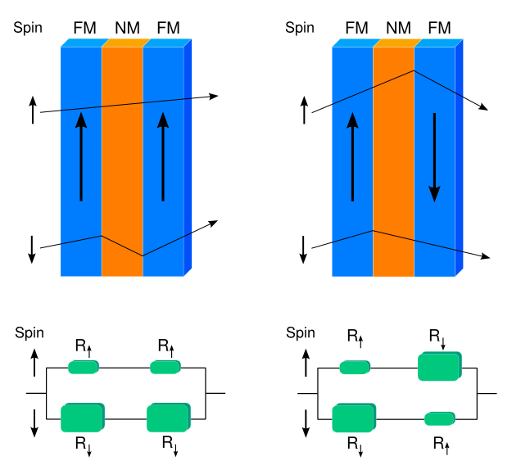
SPINTRONICS THE SOLUTION
Carrier spin used as two state device ( )
Able to integrate computing and memory into one device utilizing charge/spin.
GMR spin-valves

Slide 45
Optical storage devices
CD-ROM: compact disc ROM (Read Only Memory)
Capacity: 650MB
CD-R: compact disc recordable
CD-RW: compact disc rewritable
DVD: digital versatile disc
Capacity: 4.7GB – 17GB
DVD-R
DVD-RW
An optical disk is a high-capacity storage medium. An optical drive uses reflected light to read data.
To store data, the disk's metal surface is covered with tiny dents (pits) and flat spots (lands), which cause light to be reflected differently.
When an optical drive shines light into a pit, the light cannot be reflected back. This represents a bit value of 0 (off). A land reflects light back to its source, representing a bit value of 1 (on).

Slide 46
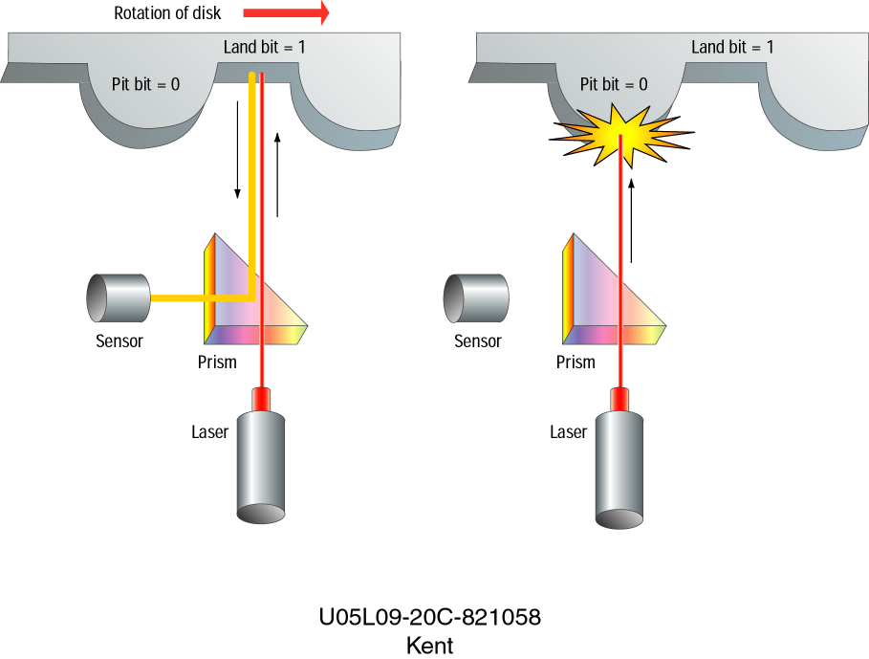
1
0

Slide 47
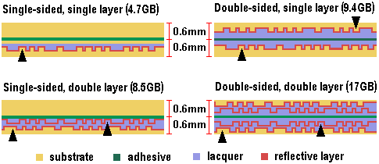
DVD (Digital Versatile Disk)
Allows up to 17 gigabytes of storage (from 4.7 GB to 17 GB).
Compatible with older CD-ROM technology.
The four versions of the DVD:

Slide 48
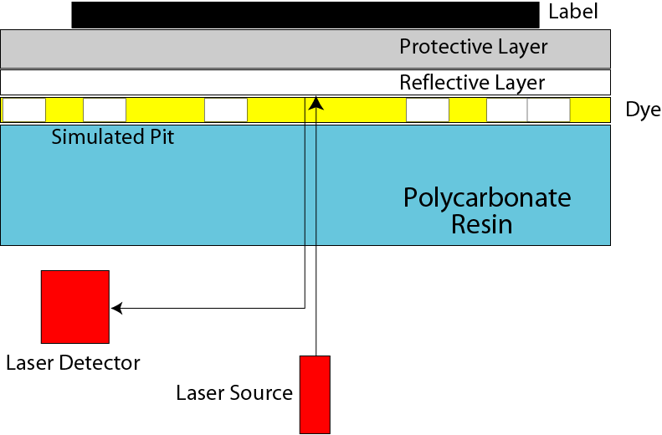
Making a CD-R

Slide 49
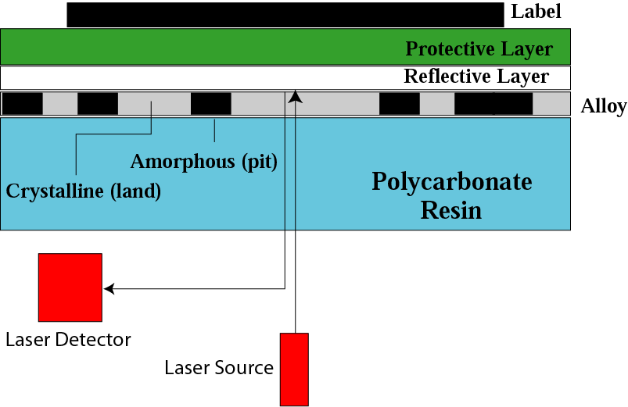
Making a CD-RW

Slide 50
Magneto Caloric Effect (MCE)
1. The magnetocaloric effect (MCE) is defined as the adiabatic change in sample temperature or equivalently as the isothermal change in entropy with the application of a magnetic field.
2. When a dc magnetic field is applied to a solid, which is thermally isolated from its surroundings, a change of the temperature of the solid may be observed. This phenomenon is known as magnetocaloric effect or, more precisely, the adiabatic temperature change due to a change of the applied magnetic field.
3. The MCE was first discovered about 120 years ago by Warburg, when he observed heat evolution in iron under the varying external magnetic field. At the beginning of the last century Langevin (1905) clearly demonstrated for the first time that the change in the magnetization of a paramagnet would generally result in a reversible temperature change.

Slide 51
Magneto Caloric Effect and Magnetic Transition
The magnetocaloric effect can give valuable information about the nature of magnetic ordering. In the case of a paramagnet and a ferromagnet, the magnetocaloric effect (ΔT_{ad}) is positive i.e. with the application of magnetic field under adiabatic conditions sample temperature increases.
When a magnetic field is applied to a paramagnetic or a ferromagnetic material, magnetic moments get oriented preferentially in the magnetic field direction. As a result magnetic entropy decreases with the application of magnetic field. Since under adiabatic condition, the total entropy of the system remains constant, it results in the increase of lattice entropy i.e. increase in sample temperature.
For an antiferromagnet, in the presence of external magnetic field, entropy associated with the magnetic sublattice antiparallel to field direction increases. The net result of the application of external magnetic field is the increase in magnetic entropy, as a result sample temperature decreases in this case. This is true provided spins are not flipping along the field direction.

Slide 52
MCE is proportional to the rate of change of magnetization, which is maximum around the magnetic transition temperature. This is because around magnetic ordering temperature, the application of a magnetic field under isothermal condition produces a larger change in magnetization than at higher or lower temperature.
Thus the magnitude of magnetocaloric effect is maximum near the magnetic transition temperature.
Above the magnetic transition temperature the magnetic moments are oriented randomly. With increasing temperature the thermal effect on the randomness of magnetic moments increases. As a result the external magnetic field will produce only paramagnetic response and the magnetocaloric effect decreases with increasing temperature.
At temperatures much lower than the transition temperature, the magnetization can not change significantly, as the external magnetic field will have small effect compared to strong exchange interaction. Thus the magnetocaloric effect for ferromagnetic systems shows a positive caret like shape with a maxima around the ordering temperature and for antiferromagnetic systems, it will be negative caret like shape with minima around the magnetic ordering temperature

Slide 53
Due to large magnetic moment of rare earths, the compounds with rare earth are potential candidates for large magnetocaloric effect.
Compound | T_{C} (K) | Magnetocaloric Effect
 |  | T_{max} (K) | ΔH (kOe) | ΔT_{ad} (K) | -ΔS (J/mol K)
DyAl₂ | 63.3 | 63.9 | 75 | 9.18 | 3.2
ErAl₂ | 13 | 13.6 | 75 | 14.26 | 4
Dy_{0.5}Er_{0.5}Al₂ | 37.8 | 38.2 | 75 | 10.46 | 6.4
GdPd | 38 | 38 | 70 | 8.7 | 3.4 (75 kOe)
Er₃AlC | 5.5 | 5 | 75.3 | 12.8 | 7.6 (75 kOe)
TbNi₂ | 37 | 38 | 75.3 | 11 | 3.6 (75 kOe)
GdNi₂ | 75 | 75 | 70 | 5.9 | -
DyNiAl | 29 | 31 | 75.3 | 6.3 | 2.2 (75 kOe)
ErNiAl | 5.6 (T_{N}) | 8 | 50 | 6 | -
Gd_{0.2}Er_{0.8}NiAl | 11 21 | 14 | 50 | 6.8 | -
Gd_{0.4}Er_{0.6}NiAl | 9 32 | 22 | 50 | 6.2 | -
GdNiAl | 23 58 | 58 | 50 | 4.1 | -
Gd₅Si₂Ge₂ | 276 299 | 280 | 50 | 16 | 18

Slide 54
METHODS OF DETERMINING THE MAGNETOCALORIC EFFECT
Magnetocaloric effect (ΔT_{ad}, ΔS) of a material can be obtained by
(1) direct measurements (Gives ΔT_{ad} only)
(2) magnetization measurements (Gives ΔS only) and
(3) heat capacity measurements (Gives both ΔT_{ad} and ΔS).

Slide 55
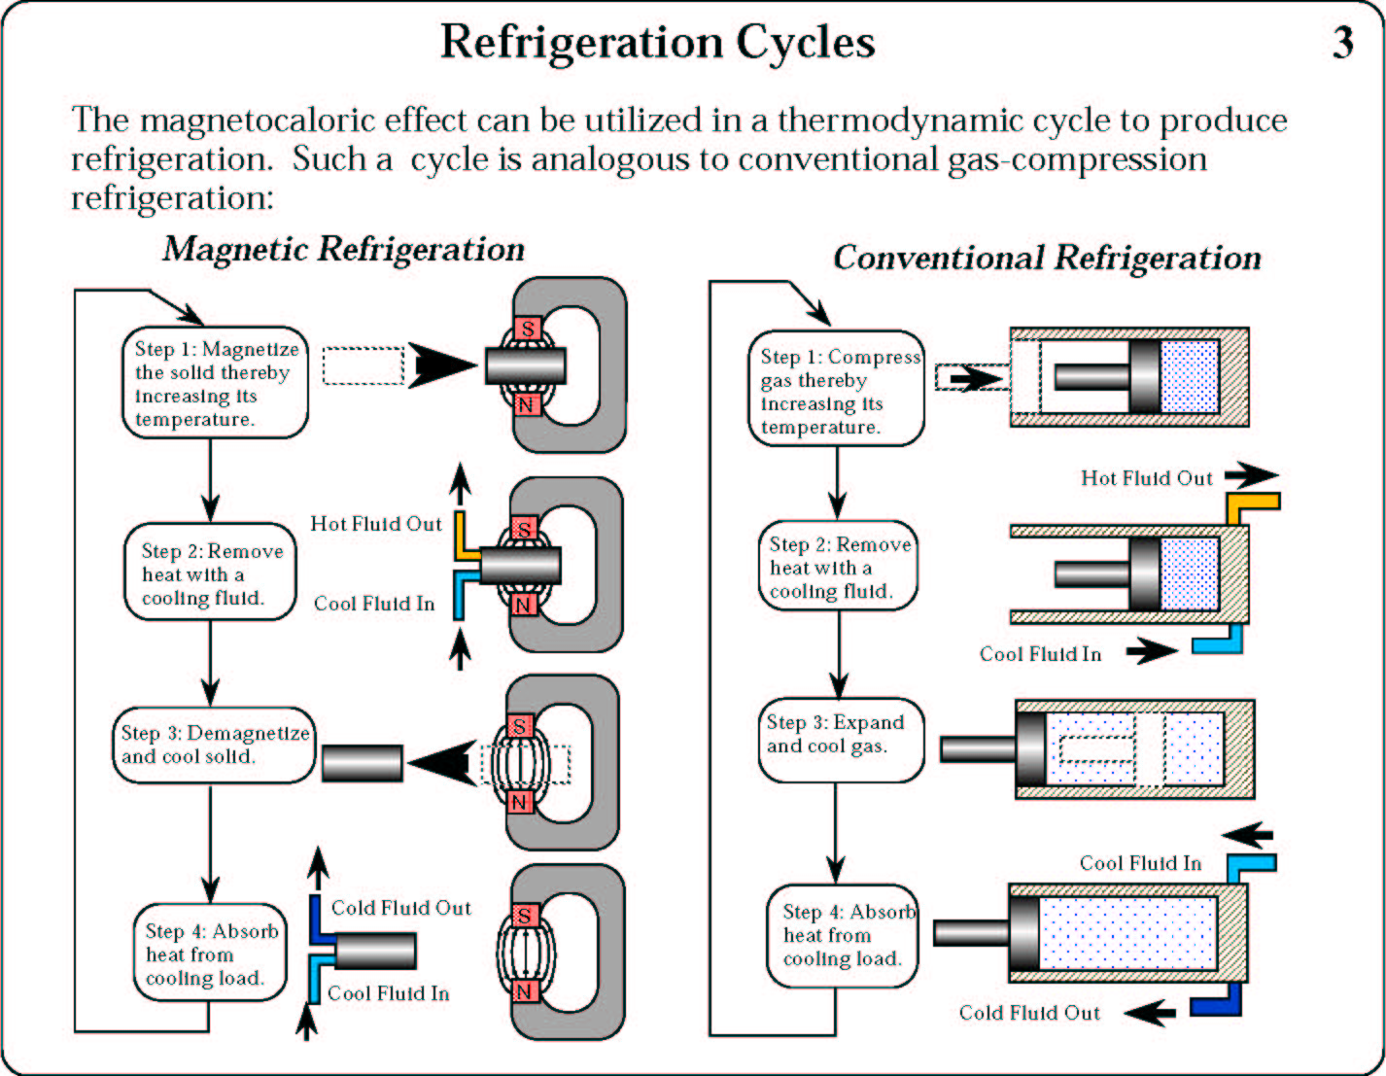

Slide 56
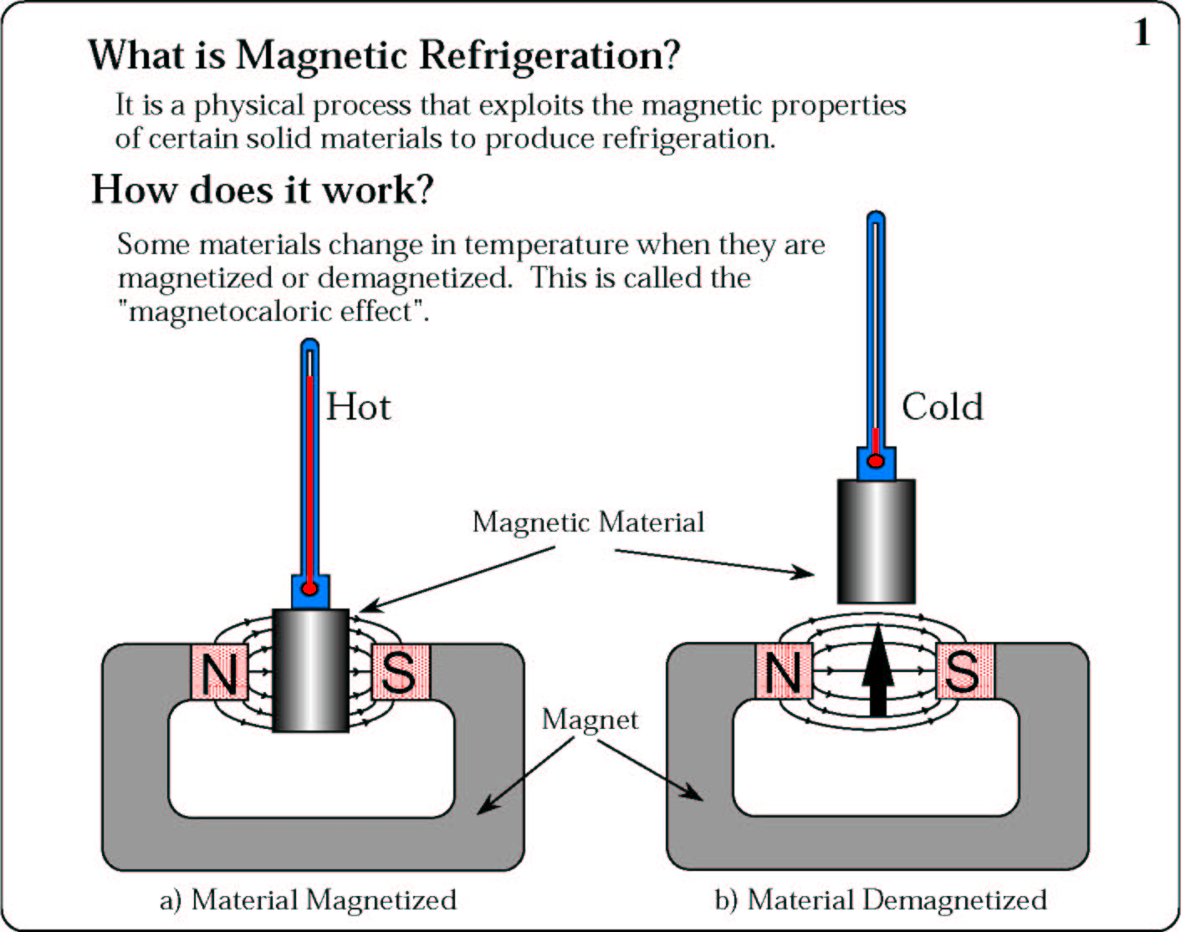
Magnetic Refrigeration
Nature 2.73K Laboratory 2μK

Slide 57
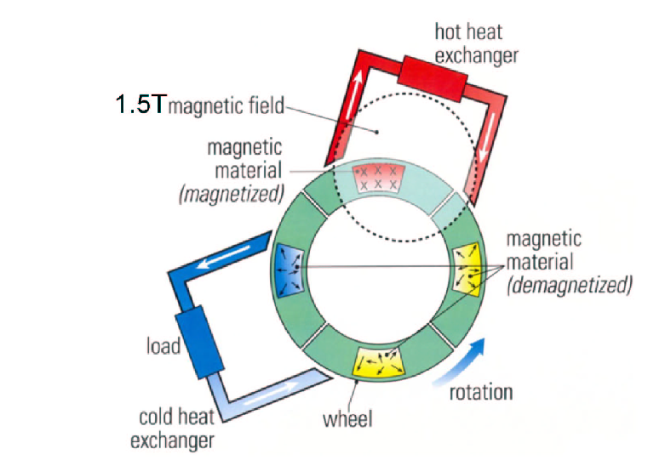

Slide 58
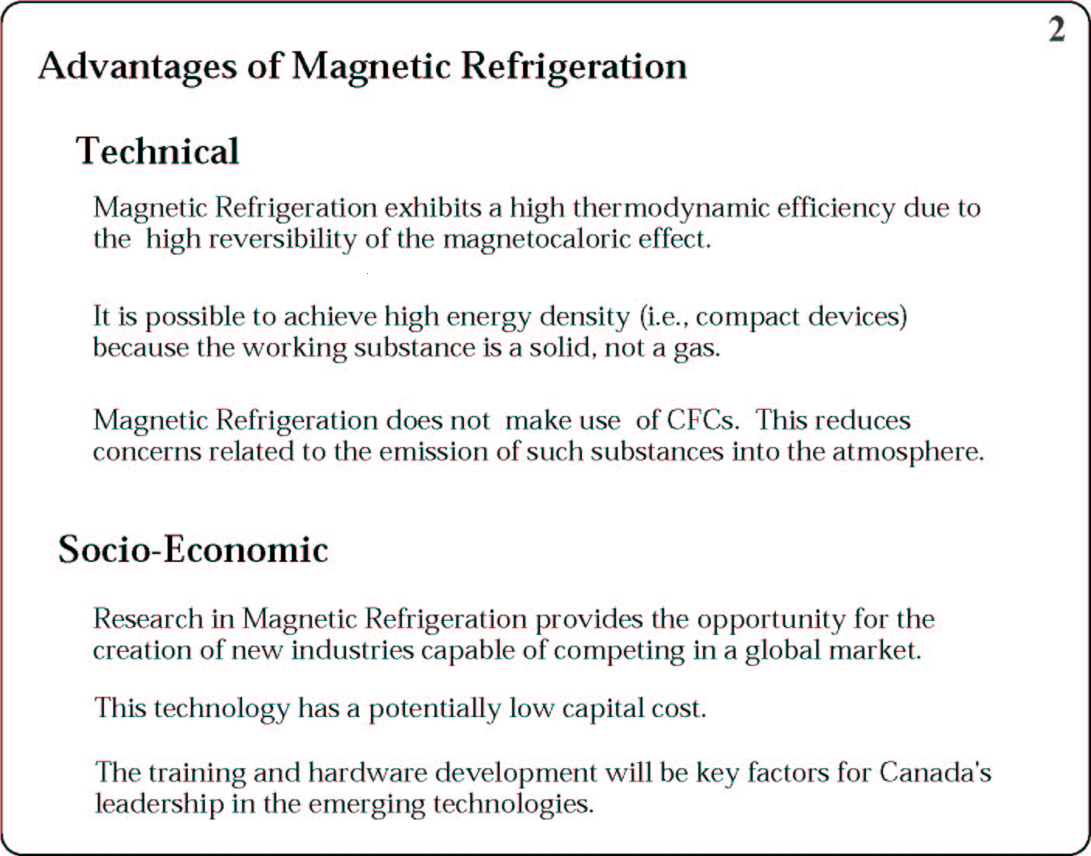

Slide 59
Other Application of MCE
1. Magneto Caloric power Generation: Heat Input -> Temperature Change
Magnetization Change
2. Increase Efficiency of Solar Cells
3. Thermo- Magnetic Mechanical Device

Slide 60
Nanomagnets in Biology
(The size of the particles can range from a few nanometers to several micrometers and thus is compatible with biological entities ranging from protiens (a few nm) to cells and bacteria (several μm))
Nanomagnets can be used to enhance signal from magnetic resonance imaging (MRI)
Diagonistics, Separation of red blood cells from blood, Cancer cell from bone marrow.
Radioactive isotopes from food products
Immunoassays
Radio pharmaceutical
RNA & DNA purification
By selecting particles of particular sizes, researchers then study specific parts of the body

Slide 61
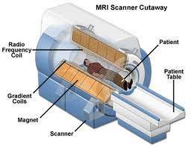
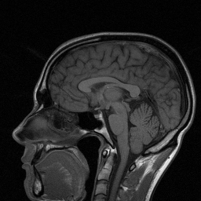
Magnetic resonance imaging (MRI), nuclear magnetic resonance imaging (NMRI), or magnetic resonance tomography (MRT)
Body tissue contains lots of water-> protons -> aligns with the application of large magnetic field. Protons align with the application of magnetic field.
A radio frequency electromagnetic wave is applied to flip the spin of the proton which is a resonance frequency. Now remove the RF signal, the spin returns back to the original position by flipping with a RF frequency. By measuring this RF signal one can image.
MRI contrast agents may be injected intravenously to enhance the appearance of blood vessels, tumors or inflammation.
Nanomagnets can be used to enhance signal from magnetic resonance imaging (MRI)
Nanoparticles with superparamagnetic properties can also be useful as a contrast agent in MRI applications. Currently paramagnetic substances like Gadolinium are used to enhance contrast on MRI images.

Slide 62
RADIOACTIVE ISOTOPES FROM FOOD PRODUCTS
Nuclear techniques are uniquely tailored for the determination of food provenance. These methodologies used for traceability and authentication of food and have the potential to be applied in many developing countries, thereby enhancing their capacities to improve food safety and quality.
(hydrogen-2/ hydrogen-1, nitrogen-15/ nitrogen-14, carbon-13/ carbon-12, oxygen-18/ oxygen-16)
Nuclear magnetic resonance, coupled with isotopic ratio mass spectrometry (NMR/IRMS) and sites pecific natural isotope fractionation by nuclear resonance (SNIF-NMR), are the two main methods to determine the ratios of stable isotopes.
CONTRAST AGENT MAGNETIC NANOMATERIALS

Slide 63
Diagonistics, Separation of red blood cells from blood, Cancer cell from bone marrow.
plasma cell myeloma or Kahler's disease, is a cancer of plasma cells , a type of white blood cell normally responsible for producing antibodies
Myeloma is diagnosed with blood tests, bone marrow examination, urine protein electrophoresis, and X-rays of commonly involved bones.
NOT CURABLE
But Nanomagnets make it possible to diagonsis and cure. How?

Slide 64
Magnetic nanoparticles are used in an cancer treatment and hyperthermia : The nanoparticles heat when they are placed in an alternative magnetic field is used.
Attaching magnetic nanoparticles to free-floating cancer cells, allowing them to be captured and carried out of the body. The treatment has been tested in the laboratory on mice and will be looked at in survival studies.
Magnetic nanoparticles can be used for the detection of cancer: Blood can be inserted onto a microfluidic chip with magnetic nanoparticles in it. These magnetic nanoparticles are trapped inside due to an externally applied magnetic field as the blood is free to flow through. The magnetic nanoparticles are coated with antibodies targeting cancer cells or proteins. The magnetic nanoparticles can be recovered and the attached cancer-associated molecules can be assayed to test for their existence.

Slide 65
CANCER TREATMENT
Heating due to magnetic field results in two possibilities
Death due to overheating
Increase in heat shock
proteins result in
anti-cancer immunity.

Slide 66
Magnetic immunoassay(MIA) is a novel type of diagnostic immunoassay utilizing magnetic beads as labels in lieu of conventional, enzymes, radioisotopes or fluorescent materials.
This assay involves the specific binding of an antibody to its antigen, where a magnetic label is conjugated to one element of the pair. The presence of magnetic beads is then detected by a magnetic reader (magnetometer) which measures the magnetic field change induced by the beads. The signal measured by the magnetometer is proportional to the analyte (virus, toxin, bacteria, cardiac marker,etc.) quantity in the initial sample.

Slide 67
Radiopharmacology is the study and preparation of radiopharmaceuticals, which are radioactive pharmaceuticals. Radiopharmaceuticals are used in the field of nuclear medicine as tracers in the diagnosis and treatment of many diseases.
Nanomagnets are used for contrast i.e. to enhance the resolution

Slide 68
RNA (Ribo-nucleic acid) extraction is the purification of RNA from biological samples. This procedure is complicated by the ubiquitous presence of ribonuclease enzymes in cells and tissues, which can rapidly degrade RNA.. Several methods are used in molecular biology to isolate RNA from samples, the most common of these are guanidium thiocyanate-phenol chloroform extraction.
Magnetic Nanoparticle with capsul structure can capture and guided by field.
Extraction of DNA (Desoxy-ribo Nucleic Acid)
Breaking the cell open, commonly referred to as cell disruption or cell lysis to expose the DNA within. This is commonly achieved by chemical and physical methods-blending, grinding or sonicating the sample.
Removing membrane lipids by adding a detergent or surfactants.
Removing proteins by adding a protease (optional but almost always done).
Removing RNA by adding an RNase(often done).
Precipitating the DNA with an alcohol — usually ice-cold ethanol or isopropanol. Since DNA is insoluble in these alcohols, it will aggregate together, giving a pellet upon centrifugation. This step also removes alcohol-soluble salt.
Either nanomagnets use in last step or it can also done like RNA capture.

Slide 69
Nanomagnets in Drug-delivery
Nanomagnets could be used for drug-delivery
Nanobeads are first laced with drug molecules
Steered by external magnetic-field gradients they reach the desired parts of the human body
This targeted drug delivery technique limits the exposure of healthy tissue to the drug
It is one of the most active areas in cancer research
It is currently the subject of clinical trials

Slide 70
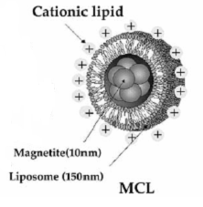
Magnetite Cationic Liposomes (MCL)
Why Cationic?
Interaction between +ve liposome and –ve cell

Slide 71
Magnetic Nanoparticles/Carriers
Magnetite Core
Starch Polymer Coating
Bioavailable
Phosphate in coating for functionalization
Chemo Drug attached to Coating
Mitoxantrone
Drug Delivered to animal
M
M
M
Magnetite
Core
M
M
Starch Polymer
M
M

Slide 72
Delivery Magnetic nanoparticles
Magnetite nanoparticles encapsulated in liposomes
(1) Antibody conjugated (AML)
(2) Positive Surface Charge (MCL)
Sprague-Dawley rats injected with two human tumors.
Lipsomes injected into 1
tumor (black) and applied
Alternating Magnetic Field

Slide 73
Magnetic Drug Delivery
Traditional drug delivery
1-Taken at predetermined intervals
2- Only small percentage of drug reaches desired target
3- Side effects common
Magnetic drug Magnetic
1-Small size allows capillary distribution and uniform perfusion at specific sites
2-Reduces chances of side effects
3-Controllable releaserate of drugs

